Slide 1
Just In Case Scheme
Update 2018

Slide 2
Background of JIC scheme?
What is JIC?
A community pharmacy enhanced service to supply a range of palliative care medications as indicated by the prescribing GP for use by district nursing teams in the event of patient deterioration in condition.
Aims of the JIC Scheme:
Improve access to palliative care medicines OOH and support the provision of care at patients’ homes.
Avoid the distress caused to patients and their families due to delayed access to medicines used for common symptoms in palliative care, especially in the terminal phase.
Ensures HCP’s can respond rapidly to worsening symptoms and avoid unnecessary suffering
Objective:
Support anticipatory prescribing and rapid access to medication by providing a Just In Case bag in the home containing the drugs that are most useful if there is a sudden deterioration in the patient’s condition.

Slide 3
Why is the update needed?
Since 2011 when the JIC was first introduced, it has been recognised there have been a number of problems relating to the use of the original JIC box scheme. Problems include:
JIC box used prescribed inappropriately rather than using anticipatory prescribing
JIC box prescribed at end of life rather than well in advance of medication being needed
Lack of flexibility of contents of the box.
Prescribers concerns about when and what to prescribe on the drug chart
Use in care homes where storage and CD requirements are an issue and where anticipatory prescribing many be more appropriate.
The amount of space required for storage of the JIC box in a CD cupboard in care homes (one box prescribed per individual patient)
Return of waste drugs – Nursing homes should not return waste drugs to pharmacies and hence there are issues with the audit trail as the JIC box scheme requires unused drugs to be returned with a completed administration sheet.
Differences in centre preferences for 1st choice opioid and anti-secretory medications.
Concerns about risk of overdose with diamorphine 30mg
The drugs in the JIC box are in line with the medication for the All Wales End of Life Care Pathway which has now been replaced by the ‘Care Decisions for the last days of Life’ document which is less prescriptive about the choice of drugs.
Use of JIC/ anticipatory prescribing by paramedics
In response an All Wales, multidisciplinary review has been undertaken and the All Wales Palliative care Pharmacist Group has revised the scheme in line with the consultation recommendations.

Slide 4
Changes
JIC BAG – no longer a box
Wider range of drugs available
One strength of diamorphine only (10mg)
Less paper work
Altered quantities of medication
Minimum suitable dose of CDs to be prescribed on WP10
Recommendation to write up prn doses on drug chart when bag issued
May annotate drug chart to instruct nurse to contact GP before administering first dose

Slide 5
The Just In Case Bag
Improved infection control
Recognisable
Low cost
Easy Storage
Not tamper proof

Slide 6
JIC Scheme 2018
A GP, District Nurse, or Palliative Care CNS in liaison with the GP will identify adult patients requiring palliative care support in their home.
If it is anticipated that the patient’s medical condition may deteriorate into the terminal phase of illness within a three month period , with the patient and carer’s agreement, the prescriber can initiate and prescribe a Just in Case bag.
The Palliative Care Just in Case bags (JIC) will be available across Wales from participating community pharmacies (enhanced service).
The prescriber can select medication to prescribe from an approved list of drugs and will be able to prescribe one of each type medicine in line with their local practice. Where appropriate they may substitute an alternative from the list.
The practice will arrange for the chosen community pharmacy to receive the prescription and supply the bag.
The bag will be kept at the patient’s home for rapid administration of medicines commonly prescribed for breakthrough symptom control.
All medicines will need to be authorised (prescribed doses, indication, directions, signed and dated) on an All Wales Medication Record chart, in order to enable a community nurse to administer the prescribed medication.

Slide 7
GP Role and Responsibilities

Slide 8
Suitable patients
Patients are identified as appropriate for a Just in Case bag by a health professional.
Patient and carers agree to a Just in Case bag.
For patients who may lack capacity to consent to the treatment contained within the Just in Case bag, health professionals should ensure that an assessment of capacity has been undertaken
Patients will have a terminal diagnosis and a prognosis of months or less (usually the Just in Case bag is introduced in the last two to three months of life).
The supply of a JIC bag in the last few days of life would not be appropriate as pharmacies require up to 72 hours to dispense a JIC bag and the quantity and choice of drugs may not be sufficient to manage the patient.
Patients should be on the practices’ palliative care register
If there are concerns about placement of a Just in Case bag with a vulnerable patient the GP is encouraged to inform the CD liaison officer, with the local police, regarding placement of the bag.

Slide 9
JIC Bag Contents
Symptom | Standard JIC | Alternative 1 | Alternative 2
Pain | Diamorphine 10mg (x5) | Morphine 10mg (x5) | Oxycodone 10mg/ml (x5)
Nausea / Vomiting | Cyclizine 50mg/ml (x5) | Haloperidol 5mg/ml (x5) | Levomepromazine 25mg/ml (x5)
Respiratory | Hyoscine Hydrobromide 400mcg/ml (x5) | Glycopyrronium 200mcg/ml (x5)
Anxiety | Midazolam 10mg/2ml (x5)
Other | Water For Injection 10ml (x5)
The prescriber will provide the completed WP10 prescription for the entire contents of the bag.
GP can select ONE medication for each indication from the approved list above, in conjunction with local guidelines and approved practices.
Where necessary substitutions can be made for alternative medications.
The GP should consider supplying sufficient medication to cover future needs, including weekends and bank holidays when access to medication may be restricted

Slide 10
Symptom Control Guidance

Slide 11
Prescription Issue
Prescriptions Requirements:
A normal WP10 prescription is generated for all the medicines contained in the Just in Case bag and signed by the GP caring for the patient.
The correct quantities must be specified and prescriptions for diamorphine, morphine, oxycodone and midazolam are subject to controlled drugs (Misuse of Drug Act and Regulations) requirements.
Doses for CDs should be the equivalent of the patient’s current equivalent break through dose or 2.5mg
The Home Office has expressed the view that a dose of “as directed” or “as required” is not acceptable for a controlled drug prescription.
The G.P. is responsible for issuing the prescription and facilitating its transfer to the chosen participating community pharmacy.
Supply of a JIC may be available via dispensing GP practices at the discretion of the appropriate LHB.
Seventy two hours should be allowed between request and collection to allow for assembly of the bag. The purpose of the JIC Bag is to provide anticipatory medication in advance of need. If medication is required immediately it should be prescribed and supplied in the usual way.
The prescriber may indicate on the Administration Record if they wish the nurse to contact a doctor before administering the first dose of a drug.

Slide 12
WP10

Slide 13
Administration Record
Prescriber encouraged to provide partially completed chart alongside initial WP10.
Community Pharmacy will supply blank chart with JIC where necessary.

Slide 14
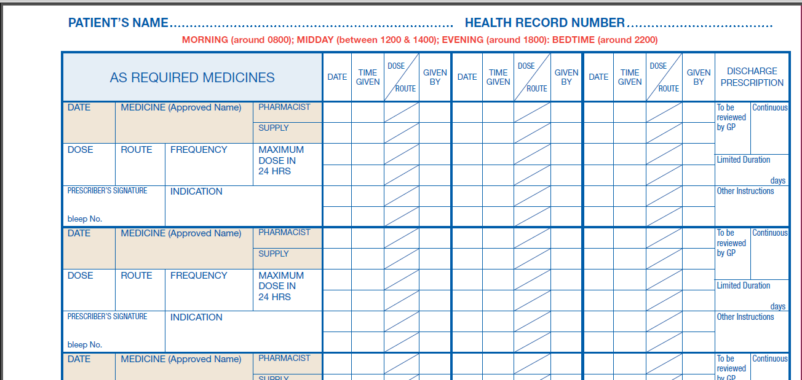
Administration instructions
Doris Jones
05/03/18 DIAMORPHINE
2.5mg SC 2-4 hrly 6
Dr Foster Pain
05/03/18 CYCLIZINE
50mg SC 4 hrly 3
Dr Foster Nausea

Slide 15
Community Pharmacy Role & Responsibilities

Slide 16
Supply of the JIC Bag
The pharmacist shall supply a JIC available within 3 working days from receipt of the WP10
Manufacturer’s original packs should be used where possible.
All drugs should have a minimum of six months expiry from the date of issue.
Each drug should be labelled as per legal and best practice requirements, and include the phrase “PRESCRIBED IN ANTICIPATION OF NEED”.
The labelled medicines, symptom control guidelines (in an envelope) and an All Wales Medication Record along with a patient leaflet should be placed in the Just in Case bag
The pharmacy must ensure the following labels are attached to the outside of the bag:-
The patient’s name and address
The expiry date of the bag
The contact name and details of the pharmacy.

Slide 17
Record Keeping
The pharmacist shall use the NECAF system (where available) to maintain records of all JIC bags supplied, including the expiry date.
Where NECAF is not available, all records and claims should be made using approved health board paperwork.
The pharmacy should keep a list of all JIC bags supplied and their expiry dates.
The pharmacist shall identify all JICs previously supplied which remain in use and are within four weeks of their designated expiry date. In these circumstances the pharmacist shall liaise with the prescriber to determine if a replacement JIC may be required.
Should an expiry date pass and the bag has not been returned the community pharmacy should liaise with the patient’s GP practice to see whether it is appropriate to contact the patient or relatives to arrange for the bag to be returned or renewed.
The above details must be kept securely and confidentially in the pharmacy. Pharmacists need to keep copies for a period of two years, in line with controlled drug documentation requirements.

Slide 18
Supplying the JIC
The pharmacy should arrange with the patient / their relative to supply the JIC bag.
Delivery to the patient’s home by the pharmacy may be possible (but is not a requirement).

Slide 19
Medication Administration
Only a healthcare professional caring for the patient may administer a medicine from the bag. The contents of the bag should be recorded in the nursing documentation.
Drugs from the Just in Case bag can be administered by a doctor, or by the community nursing team or paramedic if the medicines are authorised (prescribed doses, directions, signed and dated) by a prescriber on the patient’s All Wales Medication Administration record.
Where a medicine has not been written up in advance, the enclosed All Wales Medication Administration Record supplied with the JIC bag can be used by a prescriber to do so at the appropriate time.
If the bag is used by the out-of-hours team, the out-of-hours provider or community nurse is responsible for informing the practice by computer link the next day that the bag has been opened and arrangements made for supply of further medication if appropriate.
Community nurses requiring support or advice in managing symptoms should contact the patient’s GP or the local Out of Hours service.
When the bag is used the stock record should be completed and any remaining drugs retained for future use if needed.

Slide 20
Return/Destruction of JICs
The patient information leaflet explains the need to return the bag to the pharmacy when it is no longer required.
It is the responsibility of all practitioners to ensure the safe disposal of unused medicines in the bag, and should all work together to encourage the patient’s carers / relatives to bring the box to the pharmacy for disposal.
Pharmacies cannot collect waste from patients’ homes
Nursing homes cannot return waste to pharmacies

Slide 21
Role of LHB’s
The Local Health Board, or its authorised officer, shall provide all participating Community Pharmacies with the
Orange plastic bags – obtained from shared services
The Symptom Control Guidelines
Patient Information Leaflets
All Wales Medication Administration Record
Claims for payment shall be subject to Local Health Board arrangements for Post Payment Verification.

